Slide 1
Data Science - Intro

Slide 2
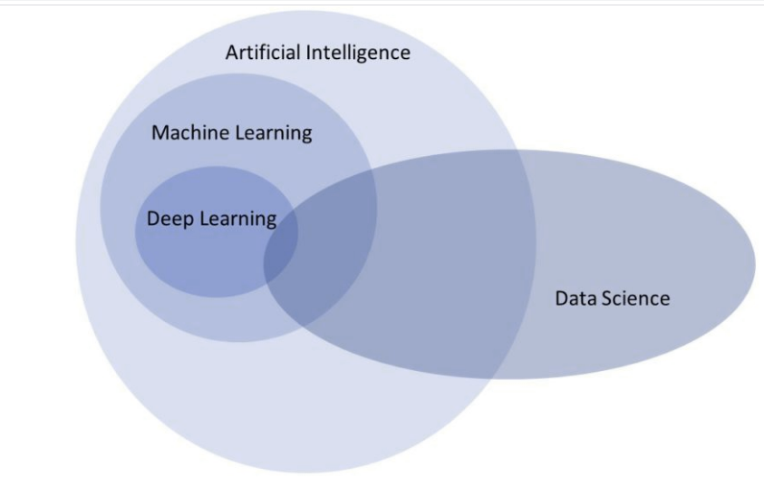
Data Science

Slide 3
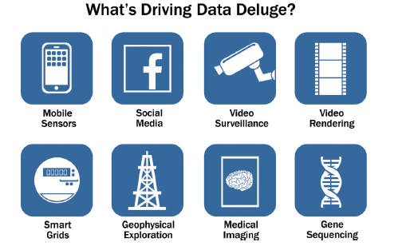
Data Deluge

Slide 4
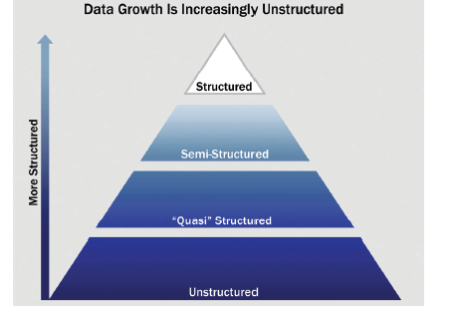
Types of Data

Slide 5
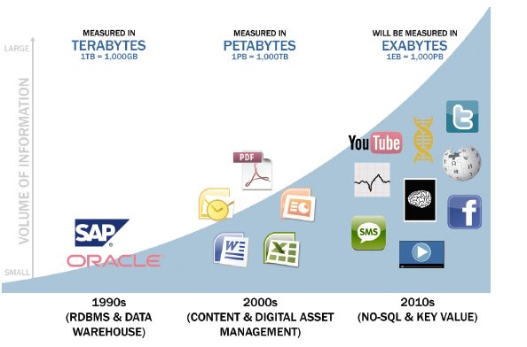
Data Evolution

Slide 6
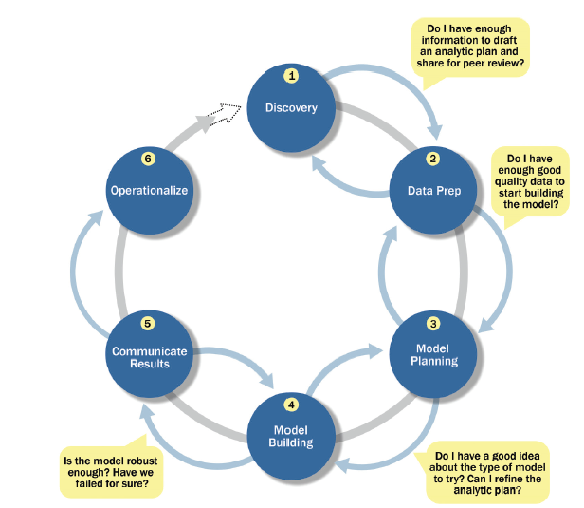
Data Science Lifecycle

Slide 7
Variables and Data
Variable : is a place holder – can hold different values that can be used for analysis. It is also referred to as Feature or Attribute
e.g. stock price, ROI, market share, age of worker, income of a family, total sales, advertising cost etc
Data : recorded measurements
Observation : An observation is an occurrence of a specific data item that is recorded
Event : An event is a collection of one or more observations

Slide 8
Types of variables
Statistical Variables
Quantitative
Qualitative
Range
Interval
Continuous
Discrete
Nominal
Ordinal
Dichotomous

Slide 9
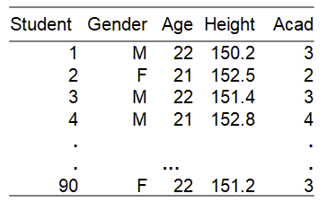
Types of variables: Example
Gender - categorical, nominal with two values “M” and “F”
Age - numerical, discrete (in years completed)
Height - numerical, continuous (in cm)
Acad - categorical, ordinal (a grade on academic background)
Student - categorical, nominal (a serial no.)

Slide 10
Practice
What type of variable is a telephone area code?
(a) numerical, continuous
(b) numerical, discrete
(c) categorical
(d) categorical, ordinal

Slide 11
Variable Name Glossary
Dependent Variable | Independent variable
Dependent | Independent
Outcome/Output | Input
Target | Predictor
Response | Explanatory

Slide 12
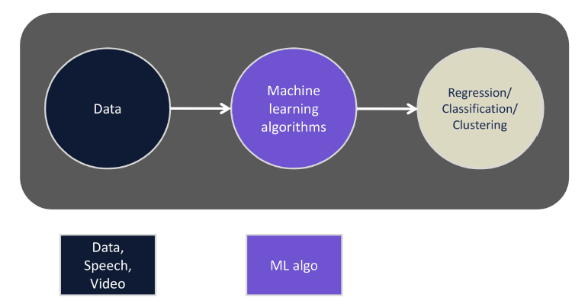
Machine Learning

Slide 13
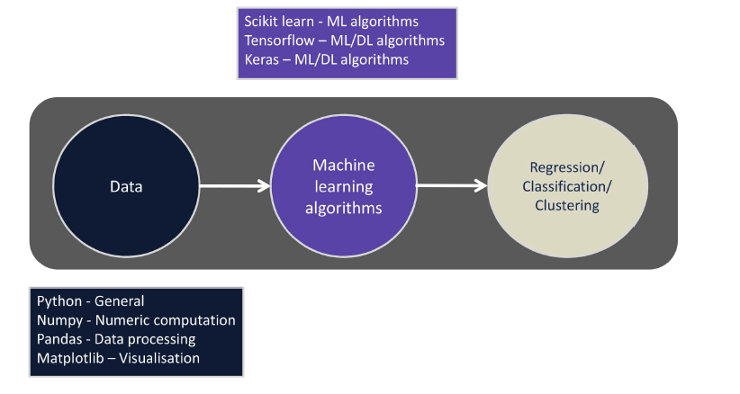
Machine Learning libraries

Slide 14
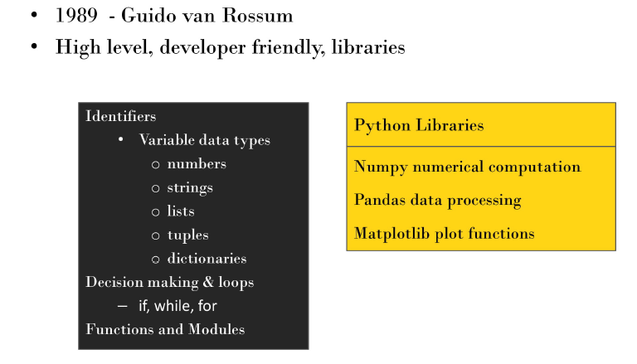
Python

